Slide 1
DEVELOPING INFORMATION SYSTEMS AND THE SYSTEMS DEVELOPMENT LIFE CYCLE

Slide 2
Systems Development Methodology
A standard process followed in an organization to conduct all the steps necessary to analyze, design, implement, and maintain information systems.
For example, a commercial product follows a life cycle in that it is created, tested, and introduced to the market. Its sales increase, peak, and decline. Finally, the product is removed from the market and replaced by something else.
The systems development life cycle (SDLC) is a common methodology for systems development in many organizations; it features several phases that mark the progress of the systems analysis and design effort.
Notes:
Most organizations find it beneficial to use a standard set of steps, called a systems development methodology, to develop and support their information systems. Like many processes, the development of information systems often follows a life cycle.

Slide 3
System Development Life Cycle
System Development Life Cycle (SDLC) The system development life cycle is classically thought of as the set of activities that analysts, designers and users carry out to develop and implement an information system.
(SDLC) is the process of understanding how an information system (IS) can support business needs, designing the system, building it, and delivering it to users.
The key person in the SDLC is the systems analyst who analyzes the business situation, identifies opportunities for improvements, and designs an information system to implement them
Notes:
Being a systems analyst is one of the most interesting, exciting, and challenging jobs around. As a systems analyst, you will work with a
variety of people and learn how they conduct business. Specifically, you will work with a team of systems analysts, programmers, and others on a common mission. You will feel the satisfaction of seeing systems that you designed and developed make a significant business impact, while knowing that your unique skills helped
make that happen. It is important to remember that the primary objective of the systems analyst is not to create a wonderful system. The primary goal is to create value for the organization, which for most companies means increasing profits (government agencies and not-for-profit organizations measure value differently).

Slide 4
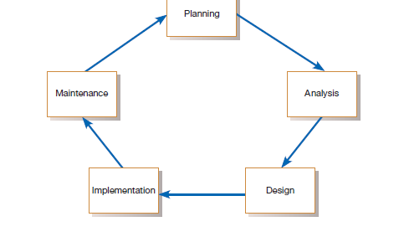
Systems development life cycle (SDLC)
The traditional methodology used to develop, maintain, and replace information systems.
Notes:
Every textbook author and information systems development organization uses a slightly different life-cycle model, with anywhere from 3 to almost 20 identifiable phases.
The life cycle can be thought of as a circular process in which the end of the useful life of one system leads to the beginning of another project that will develop a new version or replace an existing system altogether.
From the Diagram above,

Slide 5
The life cycle can be thought of as a circular process in which the end of the useful life of one system leads to the beginning of another project that will develop a new version or replace an existing system altogether.
At first glance, the life cycle appears to be a sequentially ordered set of phases, but it is not. The specific steps and their sequence are meant to be adapted as required for a project, consistent with management approaches.
Notes:
In the SDLC, it is also possible to complete some activities in one phase in parallel with some
activities of another phase. Sometimes the life cycle is iterative; that is, phases are repeated as required until an acceptable system is found.
In essence we can say that systems development life cycle used in an organization is an orderly set of activities conducted and planned for each development project.

Slide 6
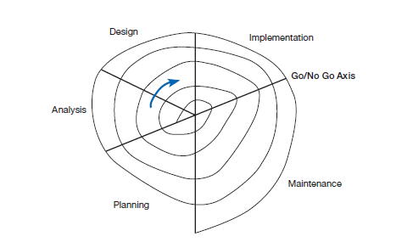

Slide 7
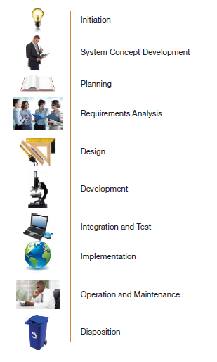
Notes:
Even if a particular methodology does not look like a cycle, and
Figure 1-4 does not, you will probably discover that many of the SDLC steps are
performed and SDLC techniques and tools are used
In many ways, building an information system is similar to building a house. First,
the house (or the information system) starts with a basic idea. Second, this idea is
transformed into a simple drawing that is shown to the customer and refined (often
through several drawings, each improving on the other) until the customer agrees
that the picture depicts what he or she wants. Third, a set of blueprints is designed
that presents much more detailed information about the house (e.g., the type of
water faucets, where the telephone jacks will be placed). Finally, the house is built
following the blueprints—and often with some changes and decisions made by the
customer as the house is erected.

Slide 8
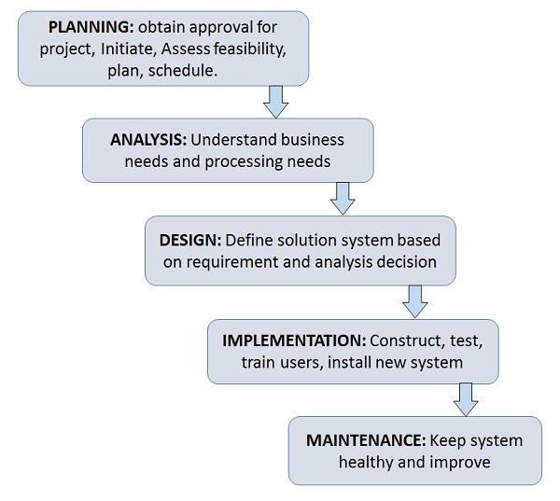
SDLC Phases
Notes:
Some books have

Slide 9
SDLC PHASES
Phases of SDLC
Each phase is composed of a series of steps or activities, which rely on techniques that produce deliverables such as specific documents and files that provide understanding about the project.
Notes:
For example, when you apply for admission to a university, there are several
phases that all students go through: information gathering, applying, and accepting.
Each of these phases has steps: information gathering includes steps like searching
for schools, requesting information, and reading brochures. Students then use techniques
(e.g., Internet searching) that can be applied to steps (e.g., requesting information)
to create deliverables (e.g., evaluations of different aspects of universities).
For now, there are two important points to understand about the SDLC. First,
you should get a general sense of the phases and steps that IS projects move through
and some of the techniques that produce certain deliverables. Second, it is important
to understand that the SDLC is a process of gradual refinement. The deliverables
produced in the analysis phase provide a general idea of the shape of the new system. These deliverables are used as input to the design phase, which then refines them to produce a set of deliverables that describes in much more detailed terms exactly how the system will be built. These deliverables in turn are used in the
implementation phase to produce the actual system. Each phase refines and elaborates
on the work done previously.

Slide 10
Phase 1.
Notes:
In this phase, someone identifies the need for a new or enhanced system. Information needs of the organization as a whole are examined, and projects to meet these needs are proactively
identified. The organization’s information system needs may result from requests to deal with problems in current procedures, from the desire to perform additional.
An important aspect of this phase is the investigation of the system problem or opportunity at hand and the presentation of reasons why the system should or should not be developed by the organization.
A critical step at this point is determining the scope of the proposed system. Which determines how big or small which aspects are being considered, what and what is involved.

Slide 11
Planning Phase
Notes:
Most ideas for new systems come from outside the IS area (from the marketing department accounting department, etc.) in the form of a system request.
NB: The first phase of the SDLC in which an organization’s total information system needs are identified, analyzed, prioritized, and arranged.

Slide 12
NB:
Most ideas for new ideas for systems development come from outside the IT or IS department. It mostly comes from other units as a System Request. A system request presents a brief summary of a business need, and it explains how a system that supports the need will create business value.
The IS or IT department works together with the person or department that generated the request (called the project sponsor) to conduct a feasibility analysis

Slide 13
Feasibility Studies
The feasibility analysis examines key aspects of the proposed project:
The technical feasibility (Can we build it?)
The economic feasibility (Will it provide business value?)
The organizational feasibility (If we build it, will it be used?)
The system request and feasibility analysis are presented to an information systems approval committee (sometimes called a steering committee), which decides whether the project should be undertaken.
Notes:
Once the project is approved, it enters project management. During project management,
the project manager creates a workplan, staffs the projects, and puts
techniques in place to help the project team control and direct the project
through the entire SDLC. The deliverable for project management is a project
plan that describes how the project team will go about developing the system.

Slide 14
Phase 2: Analysis
Notes:
Analysis
The second phase of the SDLC in which system requirements are studied and structured.
During this phase, the analyst thoroughly studies the organization’s current procedures and the information systems used to perform organizational tasks.

Slide 15
Analysis:
During this phase, the analyst thoroughly studies the organization’s current procedures and the information systems used to perform organizational tasks.
Analysis Phase is comprised of 2 subphases:
Requirement Determination: In this subphase, analysts work with users to determine what the users want from a proposed system. The requirements determination process usually involves a careful study of any current systems, manual and computerized, that might be replaced or enhanced as part of the project

Slide 16
The Second part of Analysis Phase (Analysis Study)
In the second aspect of as analysis, analysts study the requirements and structure them according to their interrelationships and eliminate any redundancies.
The output of the analysis phase is a description (also known as a System proposal) of the alternative solution recommended by the analysis team. Once the recommendation is accepted by those with funding authority, the analysts can begin to make plans to acquire any hardware and system software necessary to build or operate the system as proposed

Slide 18
Notes:
The analyses, system concept, and models are combined into a document called
the system proposal,
The system proposal is the initial deliverable that describes what business
requirements the new system should meet. Because it is really the first step in the
design of the new system, some experts argue that it is inappropriate to use the term
analysis as the name for this phase; some argue a better name would be analysis
and initial design.

Slide 19
Phase 3: The Design Phase
Design
The third phase of the SDLC in which the description of the recommended solution is converted into logical and then physical system specifications.
During design, analysts convert the description of the recommended alternative solution (from the analysis phase) into logical and then physical system specifications.
The design must include all aspects of the system, from
input and output screens
reports,
databases and database structure (tables etc to be used) and
computer processes

Slide 20
Phase 3: Design
Notes:
Although
most of the strategic decisions about the system were made in the development of
the system concept during the analysis phase, the steps in the design phase determine
exactly how the system will operate. The design phase has four steps:

Slide 21
Physical and Logical Design
Logical design:
The part of the design phase of the SDLC in which all functional features of the system chosen for development in analysis are described independently of any computer platform
Physical design
The part of the design phase of the SDLC in which the logical specifications of the system from logical design are transformed into technology-specific details from which all programming and system construction can be accomplished
Notes:
Theoretically, the system could be implemented on any hardware and systems software. The idea is to make sure that the system functions as intended. Logical design concentrates on the business aspects of the system and tends to be oriented to a high level of specificity.
In the physical design, the analysts design the various parts of the system to perform the physical operations necessary to facilitate data capture, processing, and information output.
During physical design, the analyst team must determine many of the physical details necessary to build the final system, from the programming language
the system will be written in, to the database system that will store the data, to the hardware platform on which the system will run

Slide 23
Design
The final product of the design phase is the physical system specifications in a form ready to be turned over to programmers and other system builders for construction.
Notes:
At the end of the design phase, the feasibility analysis and project plan are reexamined and revised, and
another decision is made by the project sponsor and approval committee about
whether to terminate the project or continue.

Slide 24
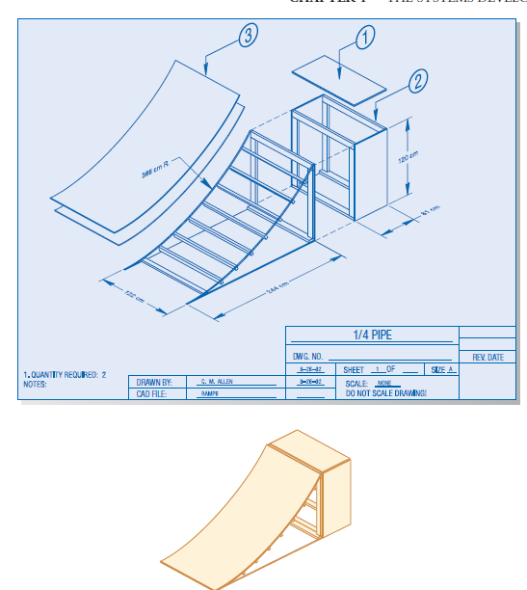

Slide 25
Phase 4: Implementation Phase
The fourth phase of the SDLC, in which the information system is coded,
tested, installed, and supported in the organization.
The physical system specifications, whether in the form of a detailed model or as detailed written specifications, are turned over to programmers as the first part of the implementation phase.
During implementation, analysts turn system specifications into a working system that is tested and then put into use. Implementation includes coding, testing, and installation. During coding, programmers write the programs that make up the system

Slide 26
Phase 4: Implementation
Notes:
This is the phase that usually gets the most attention, because for most systems it is the
The Systems Development Life Cycle 7
001-027_dennis3e_01.qxd 10/7/05 10:20 AM Page 7
longest and most expensive single part of the development process.

Slide 27
Three Implementation Steps
Notes:
Since the cost of bugs can be immense, testing is one of the most critical steps in implementation. Most organizations spend more time
and attention on testing than on writing the programs in the first place.
Installation is the process by which the old system is
turned off and the new one is turned on. It may include a direct cutover approach
(in which the new system immediately replaces the old system), a parallel conversion
approach (in which both the old and new systems are operated for a
month or two until it is clear that there are no bugs in the new system), or a
phased conversion strategy (in which the new system is installed in one part of
the organization as an initial trial and then gradually installed in others).
One of
the most important aspects of conversion is the development of a training plan
to teach users how to use the new system and help manage the changes caused
by the new system.
The analyst team establishes a support plan for the system. This plan usually
includes a formal or informal post-implementation review, as well as a systematic
way for identifying major and minor changes needed for the system.

Slide 28
Implementation Steps Explained
Coding: During coding, programmers write the programs that make up the system.
Testing: During testing, programmers and analysts test individual programs and the entire system in order to find and correct errors
Installation: During installation, the new system becomes part of the daily activities of the organization. Application software is installed, or loaded, on existing or new hardware, and users are introduced to the new system and trained
NB: Implementation can continue for as long as the system exists, because ongoing user support is also part of implementation.
Notes:
Implementation activities also include initial user support such as the finalization of documentation, training programs, and ongoing user assistance. Note
that documentation and training programs are finalized during implementation
Many well-designed systems have failed because the installation process was faulty. Even a well-designed system can fail if implementation is not well managed.

Slide 29
Phase 5: Maintenance
The final phase of the SDLC, in which an information system is systematically repaired and improved.
The fifth and final phase in the SDLC is maintenance. When a system (including its training, documentation, and support) is operating in an organization, users sometimes find problems with how it works and often think of better ways to perform its functions.
In maintenance, programmers make the changes that users ask for and modify the system to reflect evolving business conditions. These changes are necessary to keep the system running and useful.

Slide 30
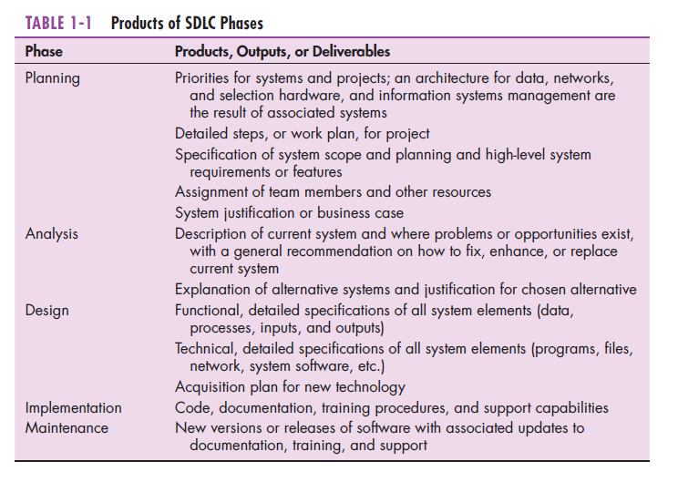

Slide 33
Notes:
Data-centered methodologies utilize data models (Chapter 7) as the core of the system concept. For example, analysts
concentrate initially on identifying the data that must be available to produce the payroll and organizing that data into well-defined structures (e.g., employee work
log, employee pay rates, payroll tax tables, employee pay history, etc.).

Slide 34
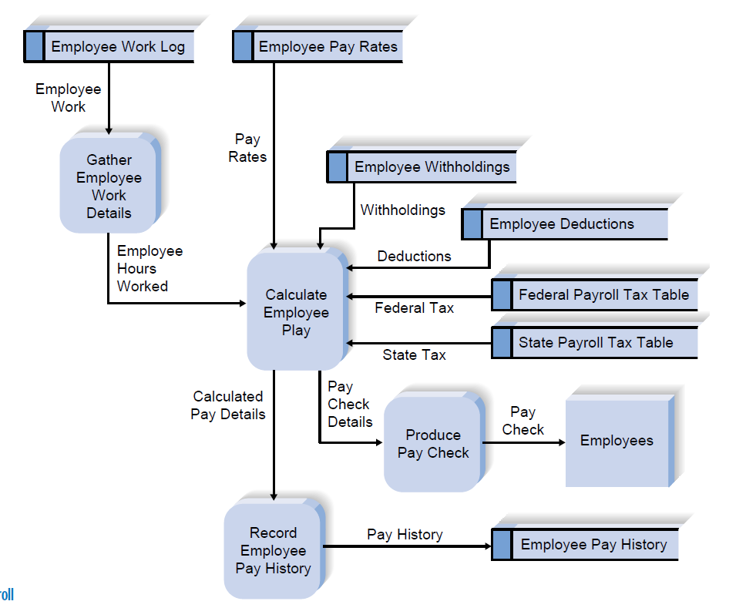

Slide 36
Methodology Categories
Another important factor in categorizing methodologies is the sequencing of the SDLC phases and the amount of time and effort devoted to each.
The three major categories of systems development methodologies that have evolved over time:
Structured Design,
Rapid Application Development (RAD)
Agile Development.
Each category represents a collection of methodologies that attempts to improve on previous practice, and varies in terms of the progression through the SDLC phases and the emphasis placed on each phase.
Notes:
4 In the early days of computing, the need for formal and well-planned life cycle methodologies was not well understood. Programmers tended to move directly from a very simple planning phase right into the construction step of the implementation phase;
This is the same approach that you may sometimes use when writing programs
for a programming class. It can work for small programs that require only
one programmer, but if the requirements are complex or unclear, you may miss
important aspects of the problem and have to start all over again, throwing away
part of the program (and the time and effort spent writing it). This approach also
makes teamwork difficult because members have little idea about what needs to be
accomplished and how to work together to produce a final product.

Slide 37
Structured Design Methodologies

Slide 38
Notes:
The key deliverables for each phase are typically voluminous
(often hundreds of pages in length) and are presented to the project sponsor for
approval as the project moves from phase to phase. Once the sponsor approves the
work that was conducted for a phase, the phase ends and the next one begins

Slide 43
Category 2: Rapid Application Development

Slide 45
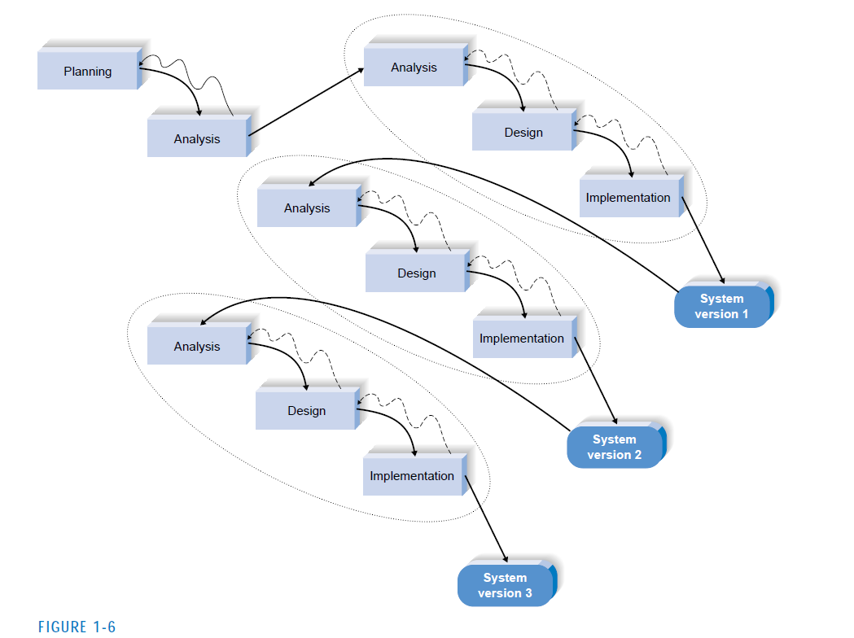

Slide 46
Notes:
With these methodologies, a basic analysis and design are performed, and work immediately begins on a system
prototype, a “quick-and-dirty” program that provides a minimal amount of
features. The first prototype is usually the first part of the system that the user
will use. This is shown to the users and the project sponsor, who provide reaction
and comments. This feedback is used to reanalyze, redesign, and reimplement a
second prototype that provides a few more features. This process continues in a
cycle until the analysts, users, and sponsor agree that the prototype provides
enough functionality to be installed and used in the organization

Slide 47
Advantages of Prototyping
The key advantage of a prototyping-based methodology is that it very quickly provides a system for the users to interact with, even if it is not initially ready for widespread organizational use. Prototyping reassures the users that the project team is working on the system (there are no longer time intervals in which the users perceive little progress), and the approach helps to more quickly refine real requirements
Notes:
Rather than attempting to understand system specification materials, the
users can interact with the prototype to better understand what it can and cannot do.

Slide 49
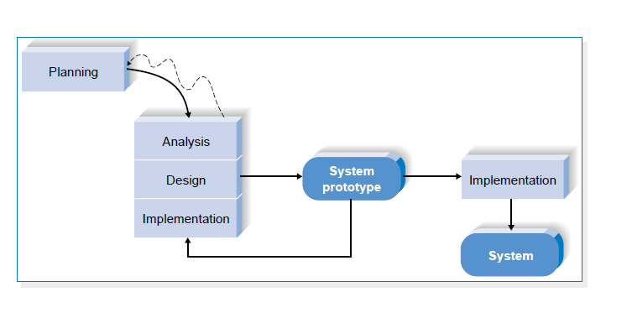

Slide 51
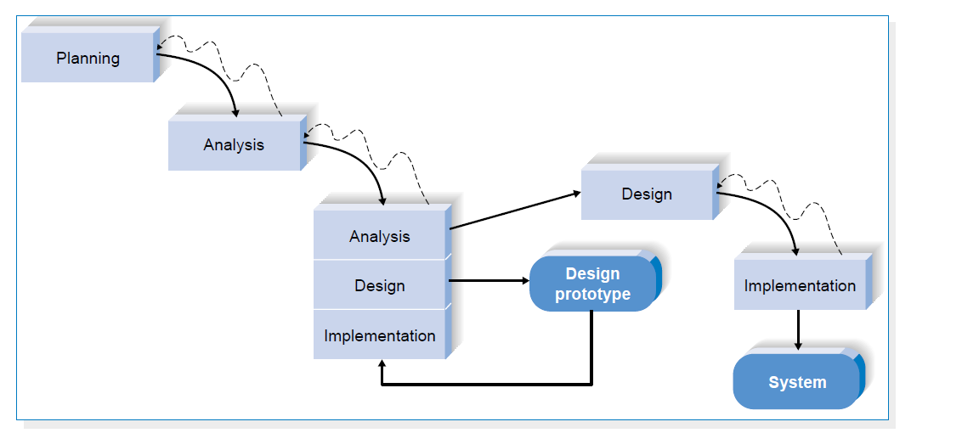
Notes:
Each of these issues is examined by analyzing, designing, and building a design prototype.
A design prototype is not a working system; it is a product that represents a part of
the system that needs additional refinement, and it contains only enough detail to enable users to understand the issues under consideration.
For example, suppose
users are not completely clear on how an order entry system should work. The analyst
team might build a series of HTML pages viewed using a Web browser to help
the users visualize such a system.

Slide 52
Category 3: Agile Development
Notes:
A third category of systems development methodologies is still emerging today:
Agile Development.7 These programming-centric methodologies have few rules and
practices, all of which are fairly easy to follow. They focus on streamlining the
SDLC by eliminating much of the modeling and documentation overhead and the
time spent on those tasks.

Slide 53
Extreme Programming: XP

Slide 54
Notes:
First, the developers
must provide rapid feedback to the end users on a continuous basis. Second, XP
requires developers to follow the KISS (Keep It Simple, Stupid) principle. Third,
developers must make incremental changes to grow the system and they must embrace change, not merely accept it. Fourth, developers must have a qualityfirst
mentality.

Slide 56
Selecting the Appropriate Methodology

Slide 57
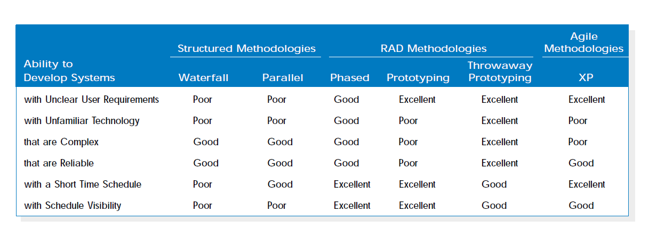

Slide 61
Draw certain specifications which are easily understood by users and programmer in precise and detailed form.
Implement the logical design of system which must be modular.
Plan the periodicity for evaluation after it has been used for some time, and modify the system as needed.

Slide 62
Main Roles
Defining and understanding the requirement of user through various Fact finding techniques.
Prioritizing the requirements by obtaining user consensus.
Gathering the facts or information and acquires the opinions of users.
Maintains analysis and evaluation to arrive at appropriate system which is more user friendly.
Suggests many flexible alternative solutions, pick the best solution, and quantify cost and benefits.

Slide 63
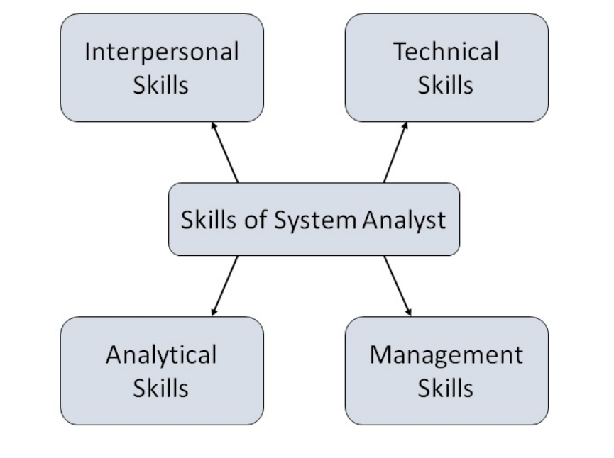
Attributes of a Systems Analyst
The following figure shows the attributes a systems analyst should possess −

Slide 64
Role of SA
Role of System Analyst
The system analyst is a person who is thoroughly aware of the system and guides the system development project by giving proper directions. He is an expert having technical and interpersonal skills to carry out development tasks required at each phase.
He pursues to match the objectives of information system with the organization goal.

